Slide 1
Getting Money Fit – Planning ahead to cope with life’s ups and downs
Jenny Wright
Regional Partnerships Manager
October 2023

Slide 2
Agenda for today
Credentials – who we are and what we do
Financial wellbeing – what does this mean?
4 Steps to Financial Wellbeing
Questions

Slide 4
We have five core functions
Money guidance
Pensions guidance
Debt
advice
Consumer protection
Strategy
We provide information designed to enhance people’s understanding and knowledge of financial matters and day-to-day money management skills.
We deliver free, impartial money guidance to millions of people through our website, our contact centre, WhatsApp and our webchat.
We provide information to people about workplace and personal pensions.
We deliver free, impartial pensions guidance through our website, technical contact centre through our pension experts and through individual appointments.
We provide people in England with information and advice on debt and are the largest single funder of free debt advice in England.
We work with government and the Financial Conduct Authority (FCA) to protect consumers against financial scams, ensuring our customers can identify and protect themselves and their finances.
We will focus the efforts of the UK Strategy for Financial Wellbeing through close collaboration with industry and stakeholders to build a financial wellbeing movement in the UK – to collectively improve financial wellbeing in the UK.
Source: Financial Guidance and Claims Act 2018 – 3.1 Functions
Notes:
What we do– scams – beware

Slide 5

Financial Wellbeing
. . . . . is about feeling secure and in control. It is knowing that you can pay the bills today, can deal with the unexpected, and are on track for a healthy financial future.
  In short, confident and empowered
Notes:
Feeling in control of your money – even if you’d like more !

Slide 6

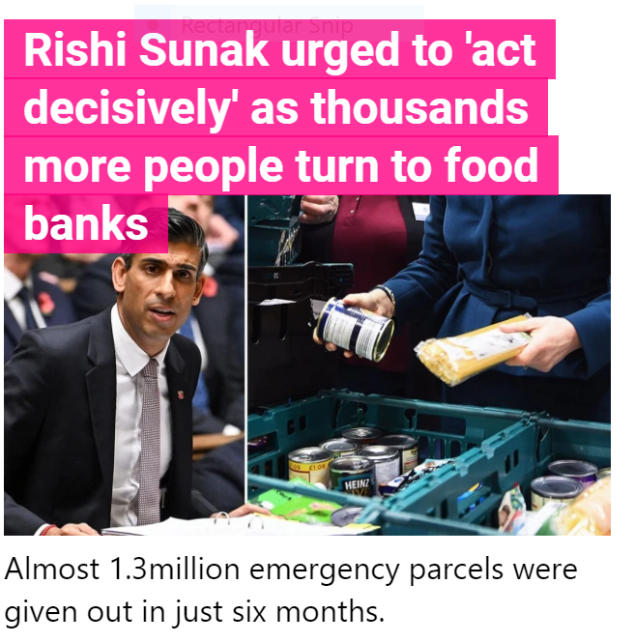


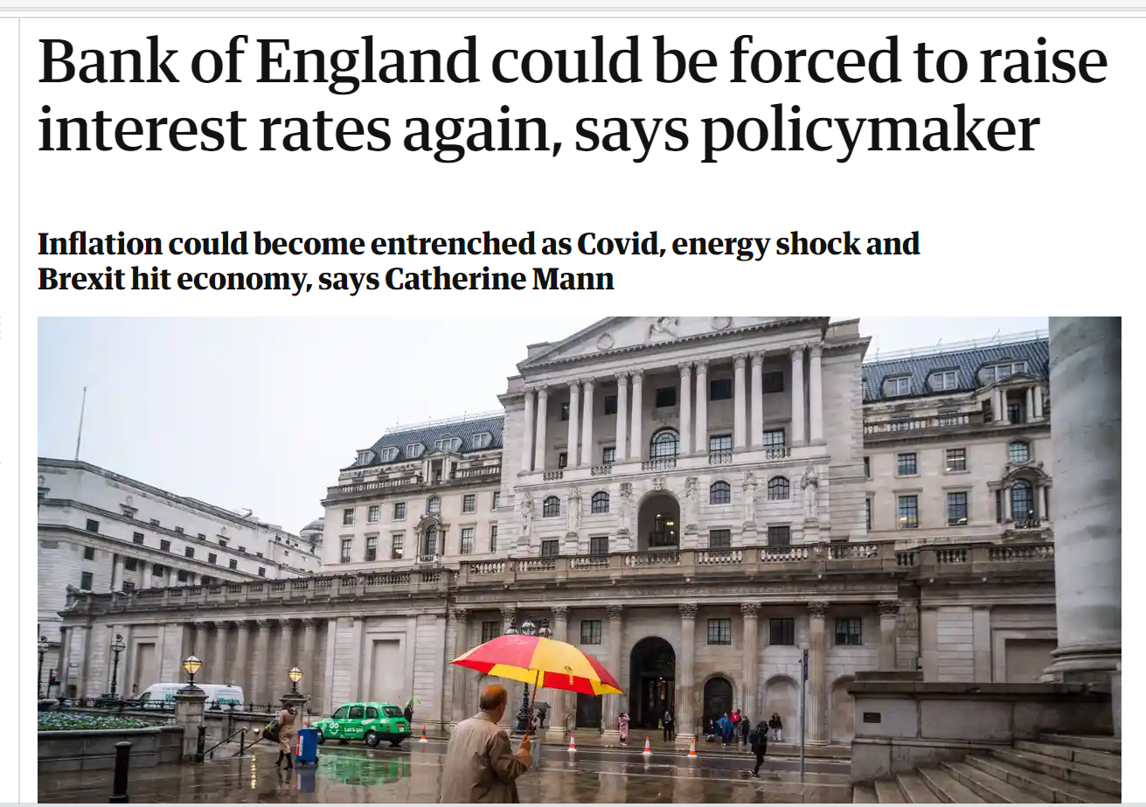

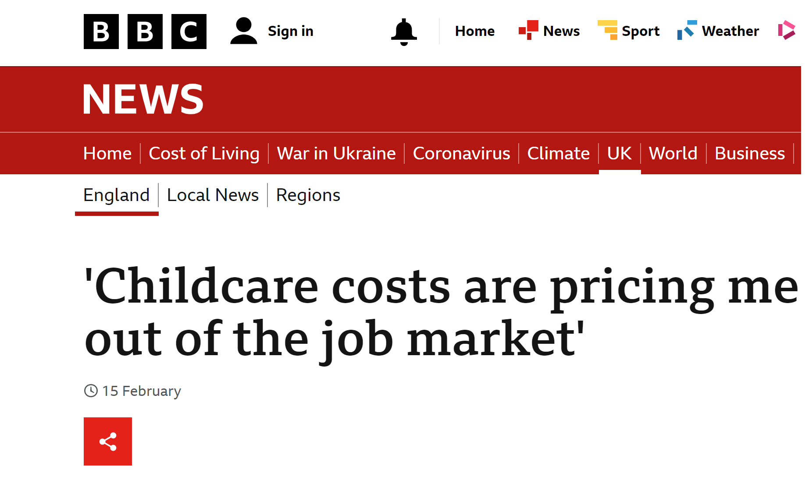

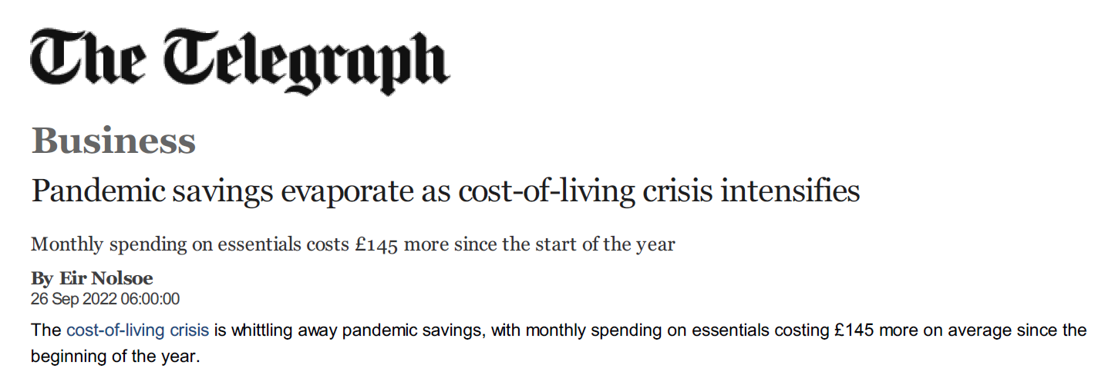

Money dominates the news
NEW
PRICESPRICES
Notes:
Uncertainty and fear

Slide 7

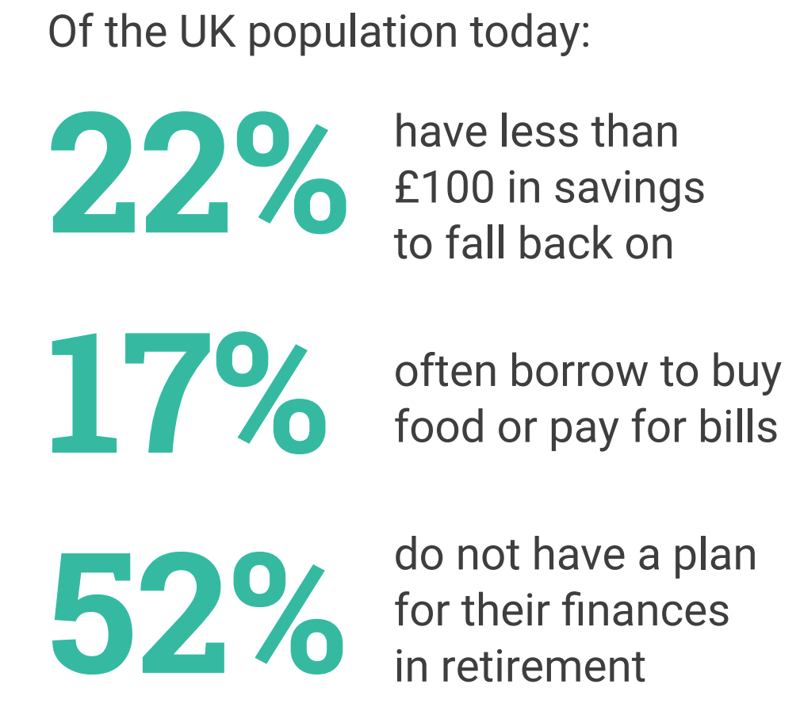
With many grappling with cost-of-living pressures and the challenges of managing their money in uncertain times, it is no surprise that 19 million people in the UK feel worried when thinking about their financial situation.
Notes:
Our research shows that………..
As part of its Financial Lives survey, the FCA found that the cost of living is having an impact on people’s mental wellbeing. Around half of UK adults, or 28.4 million people, in January 2023 felt more anxious or stressed due to the rising cost of living than six months earlier. The cost of living has been a real issue for a while now and a great source of support and information is our money helper website.

Slide 8

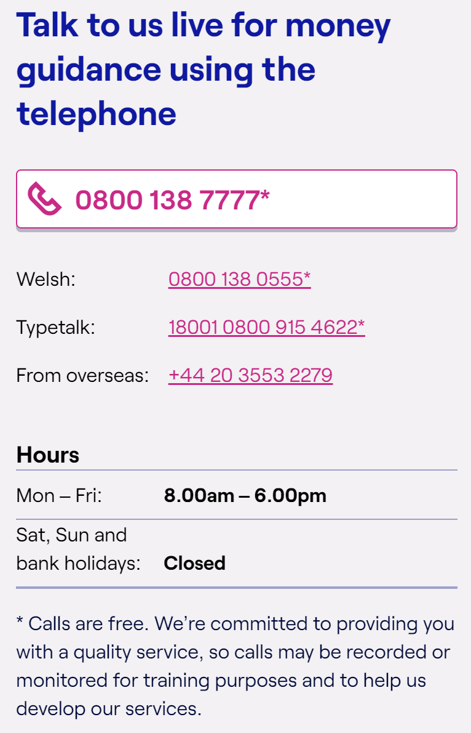

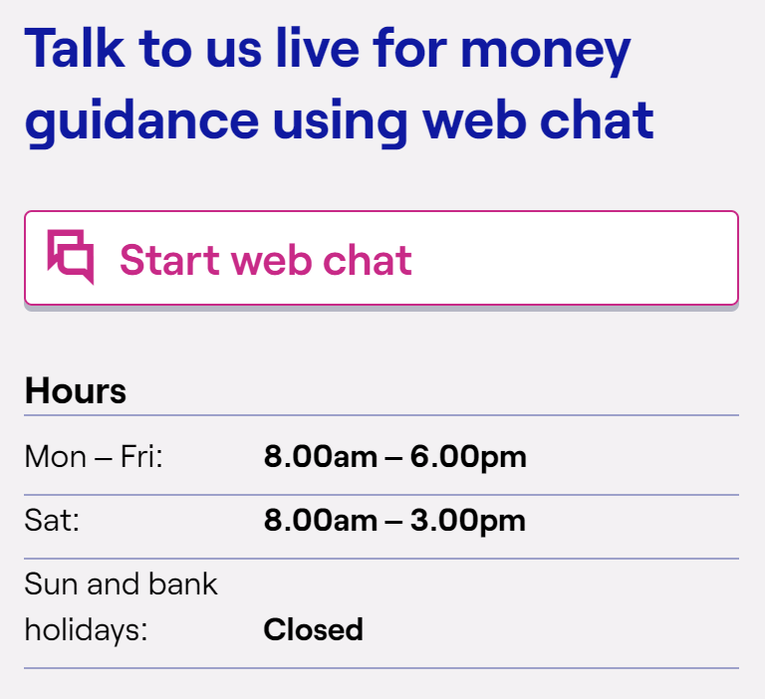
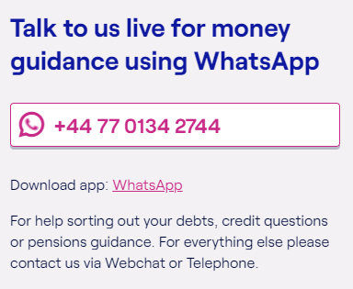
Money Guidance
Notes:
Navigate the jargon

Slide 9


Steps to Financial Wellbeing
    Taking control of your money
    Get the money you’re entitled to
    Plan for the unexpected
    Secure your future
Notes:
Ideas of where we can support
It does take effort on your part
It’s important you get help for things you don’t understand
Help is available if you can’t cope

Slide 10
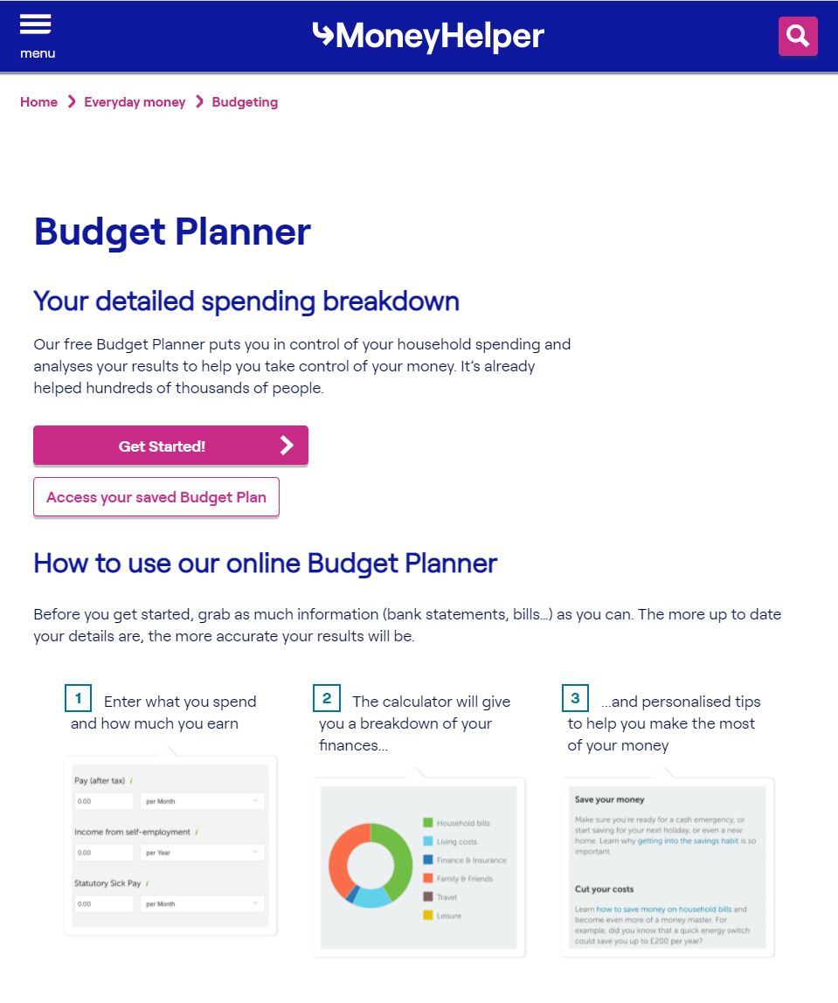


    1. Taking control of your money
Tips
Invest in me:
I will use 30 minutes of my time this week to do my household budget ….☺
Don’t forget to budget for annual bills and things like holidays and gifting occasions
Use your bank statements to help check for regular bill payments
If you use cash a lot, try to record what you spend it on
Notes:
Over half of UK households keep a regular budget.
Most say it gives them peace of mind about how much they are spending and makes them feel better about life in general.
Manage your money better with our Budget planner tool.
Do this once per year/once per week
Invest in yourself
Think about your priorities, upcoming bills

Slide 11
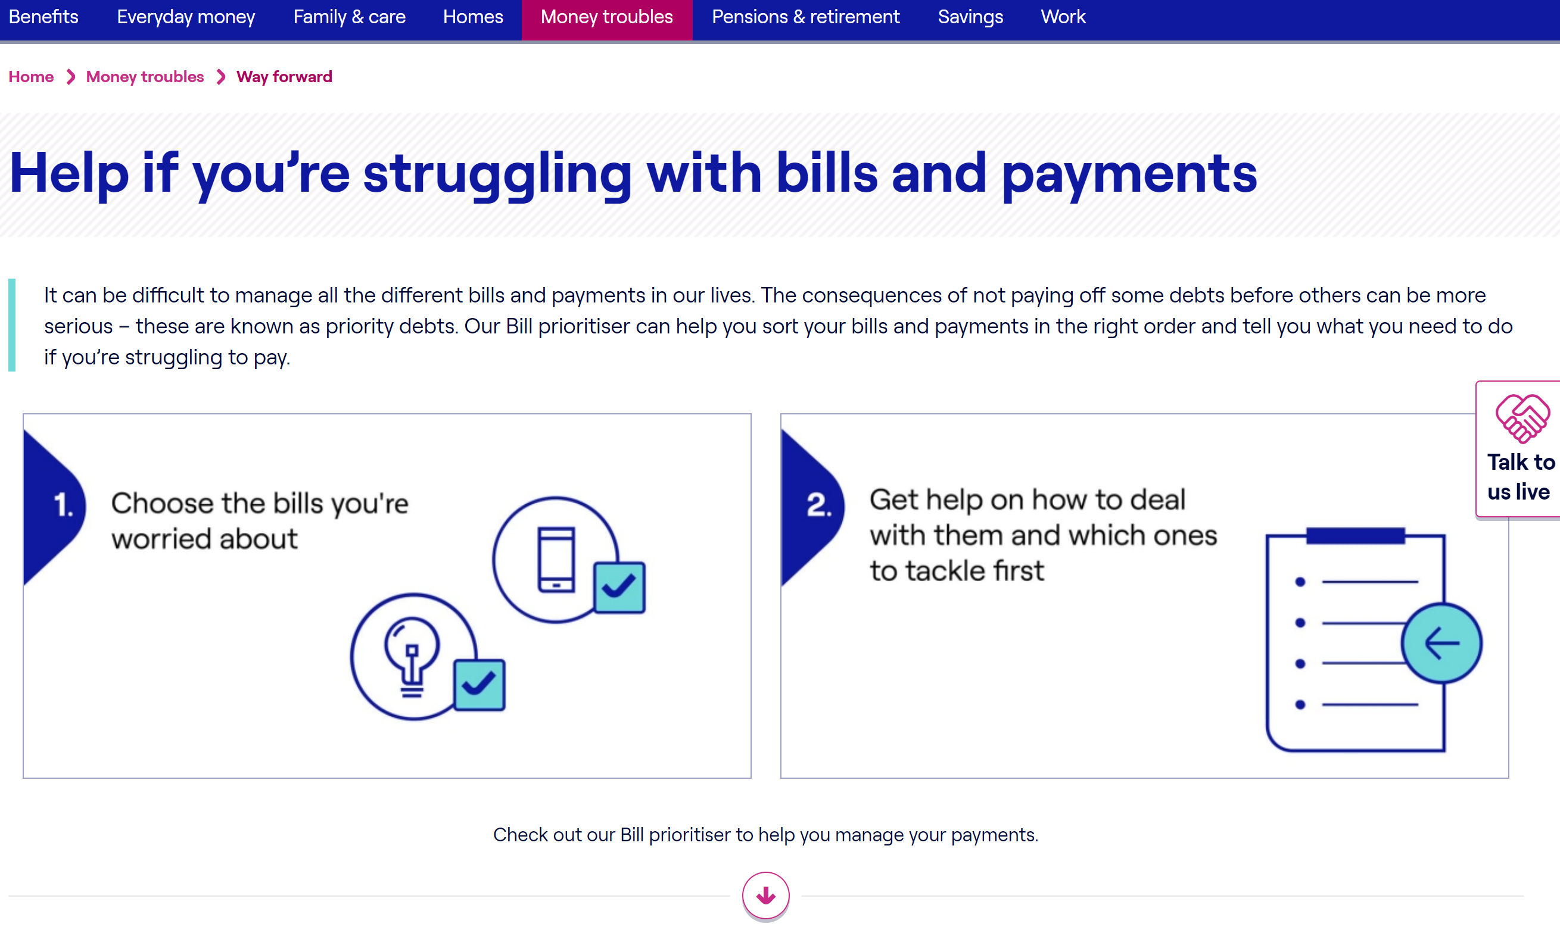
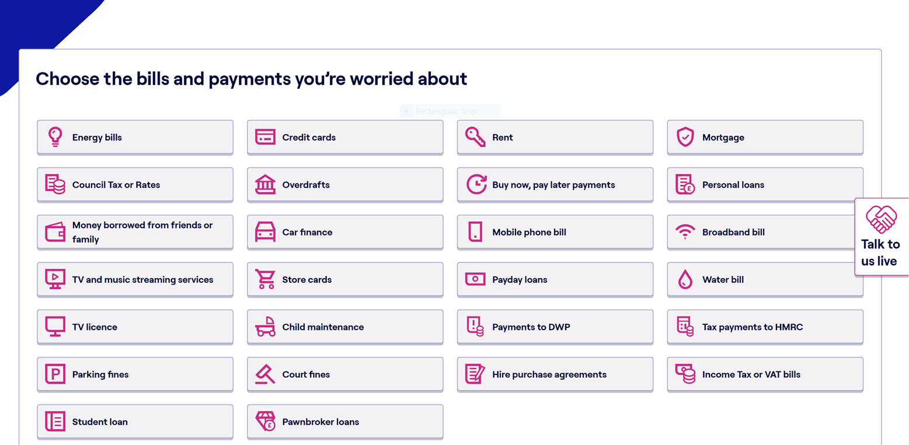
Taking Control - Bill Prioritiser
Help with bills and payments | MoneyHelper
Notes:
These are tools to help you prioritise keep on track
Help your understanding
Within this section on the website there are scripts about how to have difficult conversations with creditors, mortgage interest rates for examples.
Giving confidence to have these types of conversations
No head in the sand approach

Slide 12




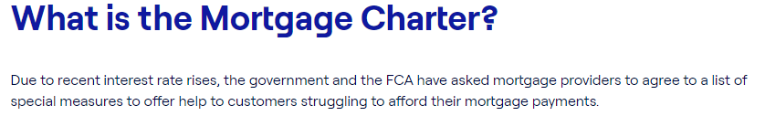
Notes:
Free
Impartial
Confidential
Expert
We have invested on behalf of England £83 million on the provision of free debt advice for England. This is available to you and its free can be transformative for people

Slide 13




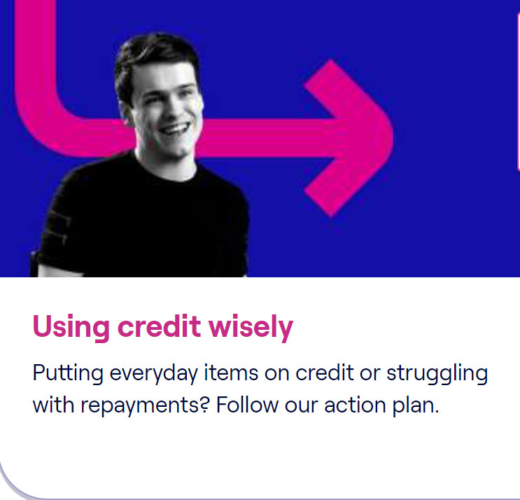

Cost of Living help, your questions answered
Notes:
Lots of information re cost of living on our website
If you are a homeowner this is what to do is your mortgage interest rates go up
Implications of stopping pension payments to gain more cash in pocket

Slide 14
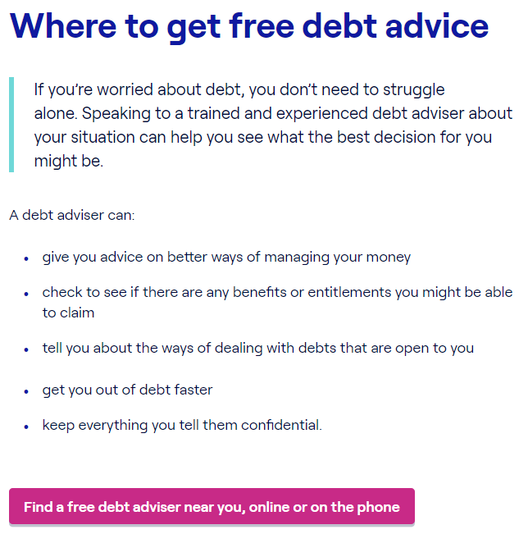
    Free Debt Advice
Tip
Don’t let your wellbeing suffer, most people who have received debt advice tell us they feel less stressed or anxious and more in control of their life again.
Seek advice sooner rather than later.
Notes:
Free
Impartial
Confidential
Expert
We have invested on behalf of England £83 million on the provision of free debt advice for England. This is available to you and its free can be transformative for people

Slide 15
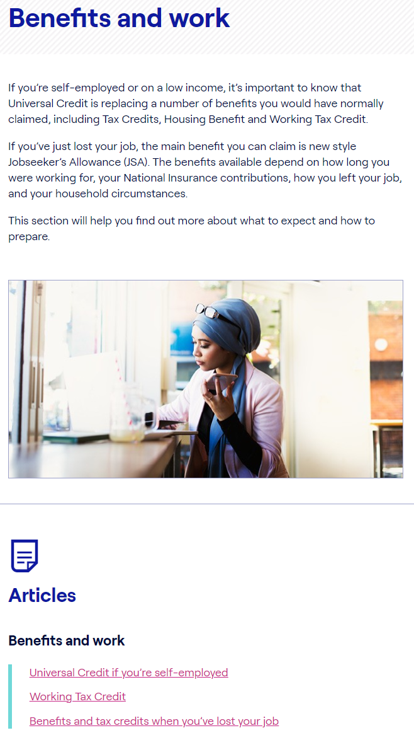
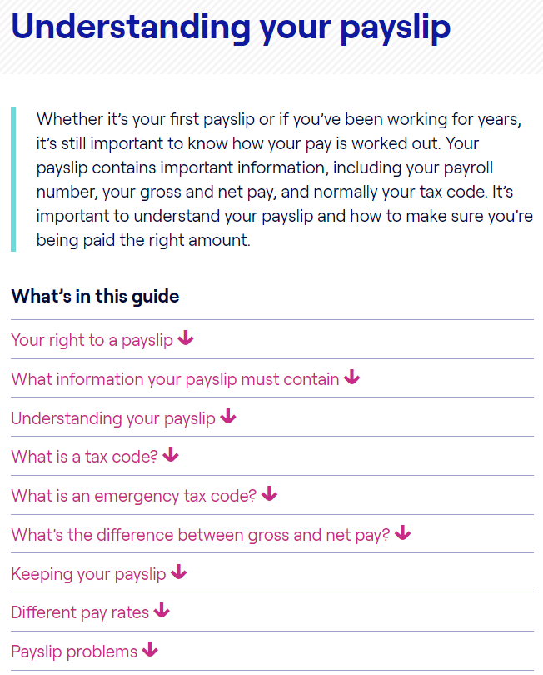
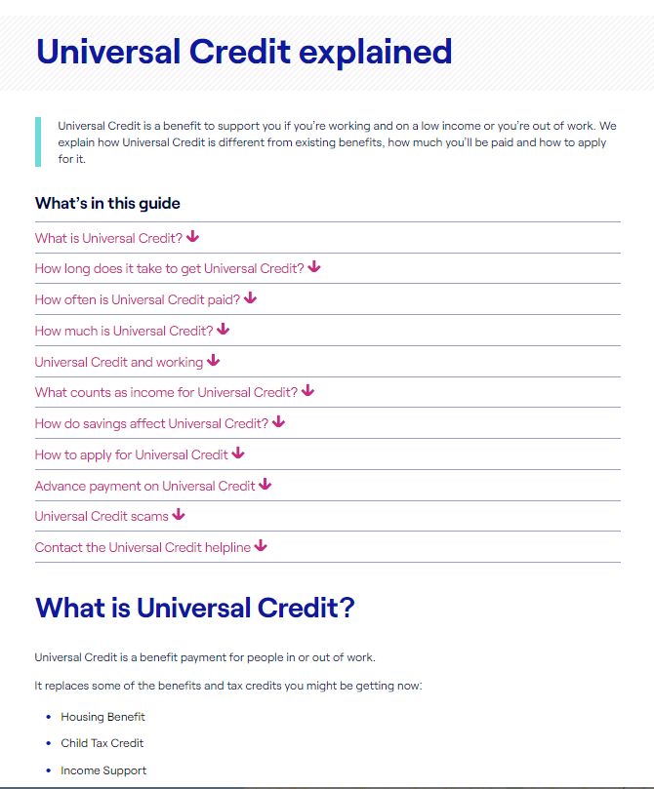
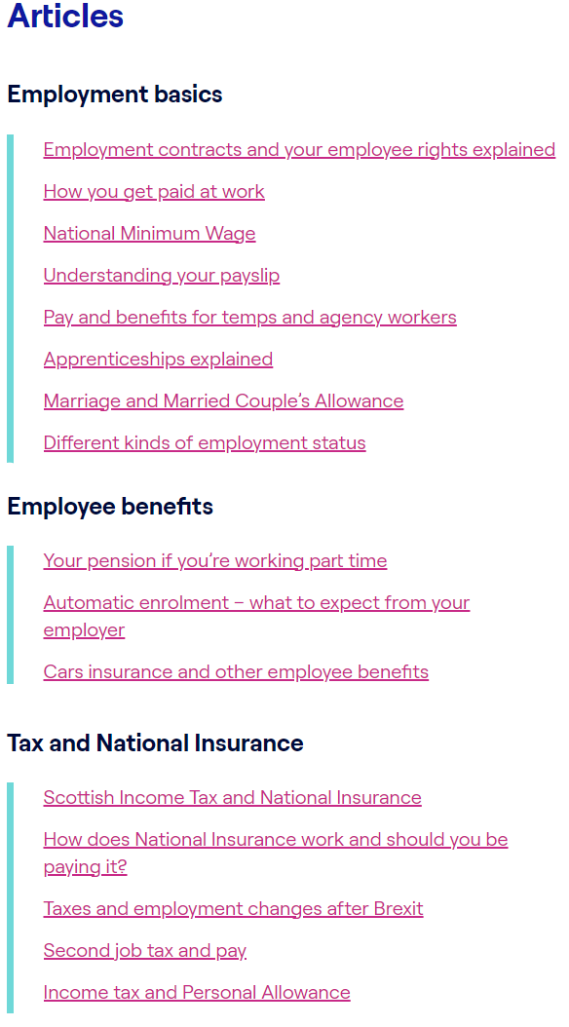
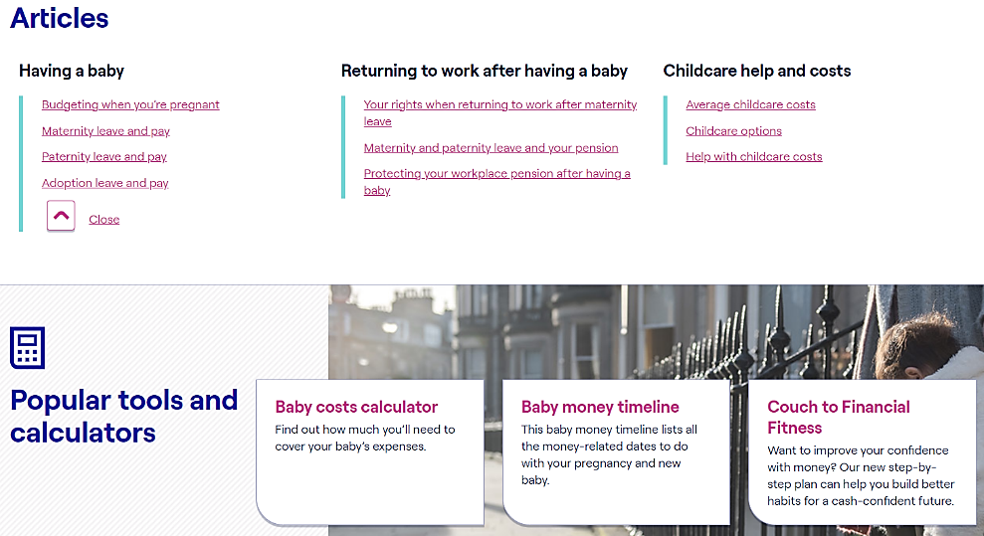
    2. Get the money you are entitled to
Make sure you’re being paid the right amount. Check your payslip and tax code
  www.moneyhelper.org.uk/understanding-your-payslip
Don’t miss out on help when it’s available — make sure you’re claiming all the benefits you’re entitled to https://www.moneyhelper.org.uk/en/benefits/use-our-benefits-calculator
Having a baby or adopting? Find out what help is available
  www.moneyhelper.org.uk/baby-benefits
Childcare costs can take up a large chunk of your family’s income. Find out what help is available
  https://www.moneyhelper.org.uk/en/family-and-care/becoming-a-parent/help-with-childcare-costs
Notes:
Maximise income
UC
People can qualify for in work benefits – childcare costs, carer costs
New benefits calculator from inbest
Ensure tax code is correct
Know your rights in terms of maternity benefits child benefits

Slide 16
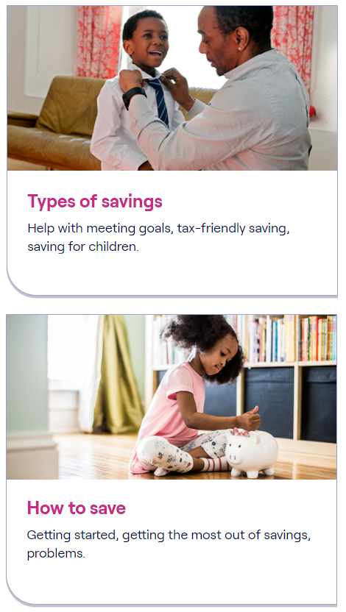

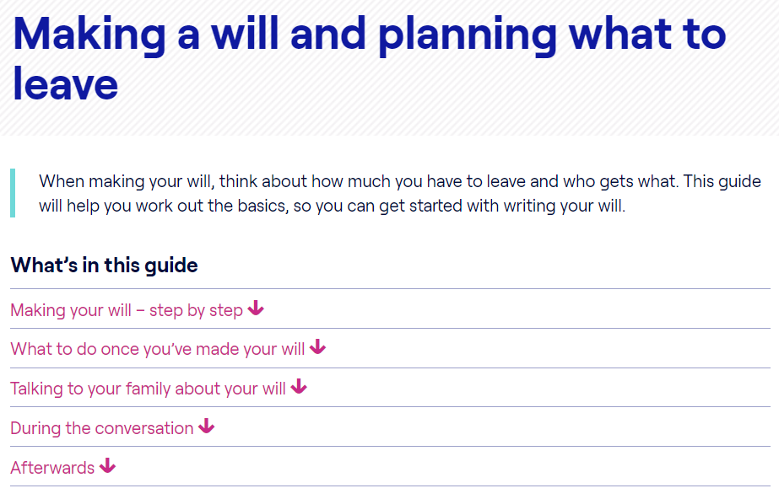
    3. Plan for the unexpected
Saving for the unexpected and emergencies
  This is often called ‘rainy day’ money. People save to make sure they have money available if something unexpected happens, like their car breaking down, a broken washing machine or boiler, or a bill that they hadn’t budgeted for
Choose who will receive your pension savings in the event of your death
  www.moneyhelper.org.uk/dependants-in-retirement
Find out why you should make a will and how to go about it
  www.moneyhelper.org.uk/making-a-will
Notes:
Insert image of local credit union
1p a day saving challenge
The one thing that makes people feel more financially confident is knowing they have savings behind them,
Emergency savings pot is a great way to feel in control and confident
Many people ask whether its worth saving if they have credit card debt – have a look at an article
We have calculators that show how much interest you are making vs how much you are gaining on your credit card
Other options to a credit card, credit union encourages saving alongside credit so you have funds after loan ends

Slide 17
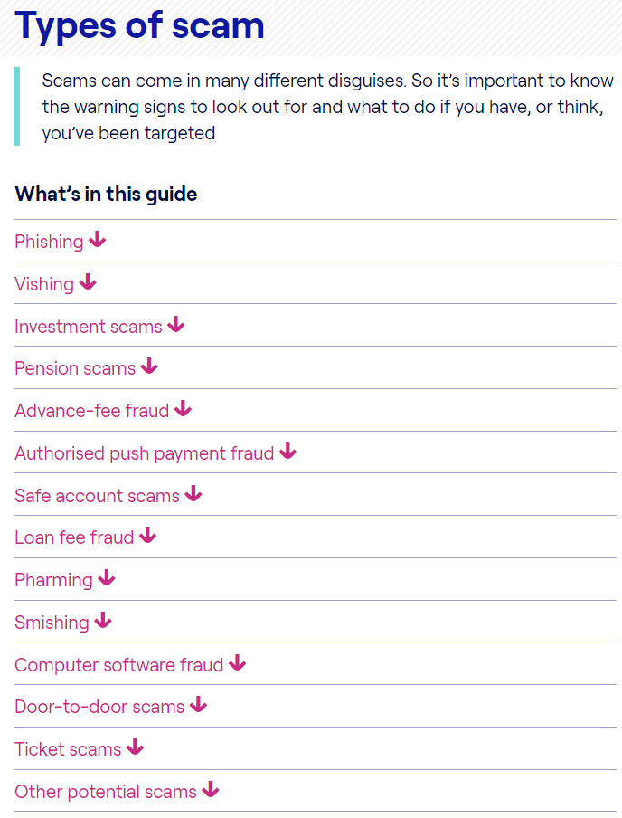
    3. Plan for the unexpected
Life events – redundancy, death of a loved one, menopause
Appoint someone you trust who can act on your behalf if
you become unable to manage your own affairs
  www.moneyhelper.org.uk/power-of-attorney
Ending a relationship can have financial consequences – knowing your options can ease the process and lower
the cost
  www.moneyhelper.org.uk/divorce-and-money-calculator
Scams come in all shapes and sizes. Learn how to spot
the signs and avoid losing your hard-earned money
  www.moneyhelper.org.uk/scams
Notes:
Relationship breakdown
Unexpected events Covid?
Bad things happen, unexpected things happen, loose family members, information and support on website
Beware information on scams more prevalent
WE have a scam squad on our freephone contact number

Slide 18
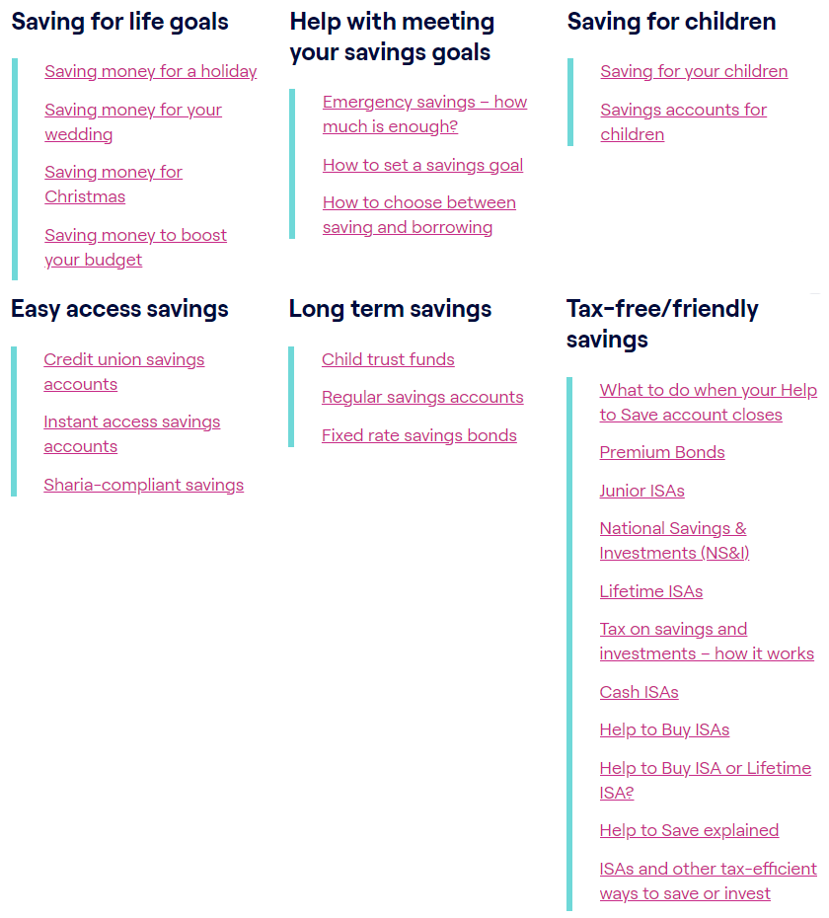
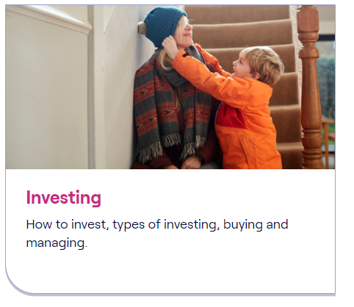
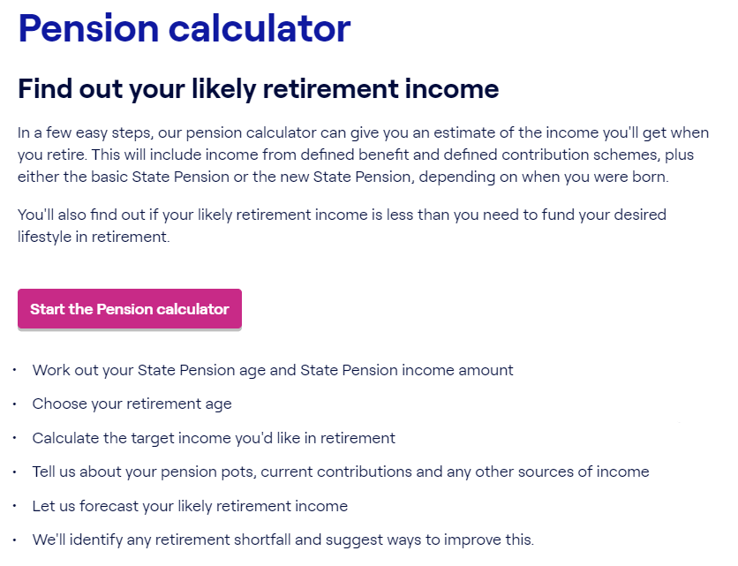
    4. Secure your future
Work out how much you can afford to save and find out how to set and reach your savings goal
  www.moneyhelper.org.uk/savings-habit
If investing is an option, here’s how you can get started
  www.moneyhelper.org.uk/beginners-guide-to-investing
Check out your workplace pension provision
  https://www.moneyhelper.org.uk/en/pensions-and-retirement/pensions-basics
Check how much you’re saving and use our pension calculator to find out if it’s enough
  https://www.moneyhelper.org.uk/en/pensions-and-retirement/auto-enrolment/workplace-pension-calculator
Notes:
Investments
Pensions
Other savings
State pension £185.15 per week
Medium to longterm savings and investments
Reasons to save medium to longterm – might want to help children with higher education fees

Slide 19
Child Trust Funds – Are your children owed money?
Individual accounts issued to almost all six million children born in the UK from 1st September 2002 to 2nd January 2011
2x£250 Govt. contribution generally, 2x£500 at least for Child Tax Credit families
Eligible children were those born between 1 September 2002 and 31 August 2005.
If parent/guardian had not opened the account by child’s first birthday, HMRC did so
5 million accounts (including the 1.8m HMRC-allocated) are invested in stock market funds – 1 million (parent-opened) in cash
Total value is over £9bn, of which Govt. contribution was £3.3bn
Search at www.findctf.sharefound.org
The state of 18/19 year-olds’ Child Trust Funds
420,000 Cash withdrawn
62,000 Active saving
550,000 No action taken estimated total value £0.75bn
Notes:
Investments
Pensions
Other savings
State pension £185.15 per week
Medium to longterm savings and investments
Reasons to save medium to longterm – might want to help children with higher education fees

Slide 20

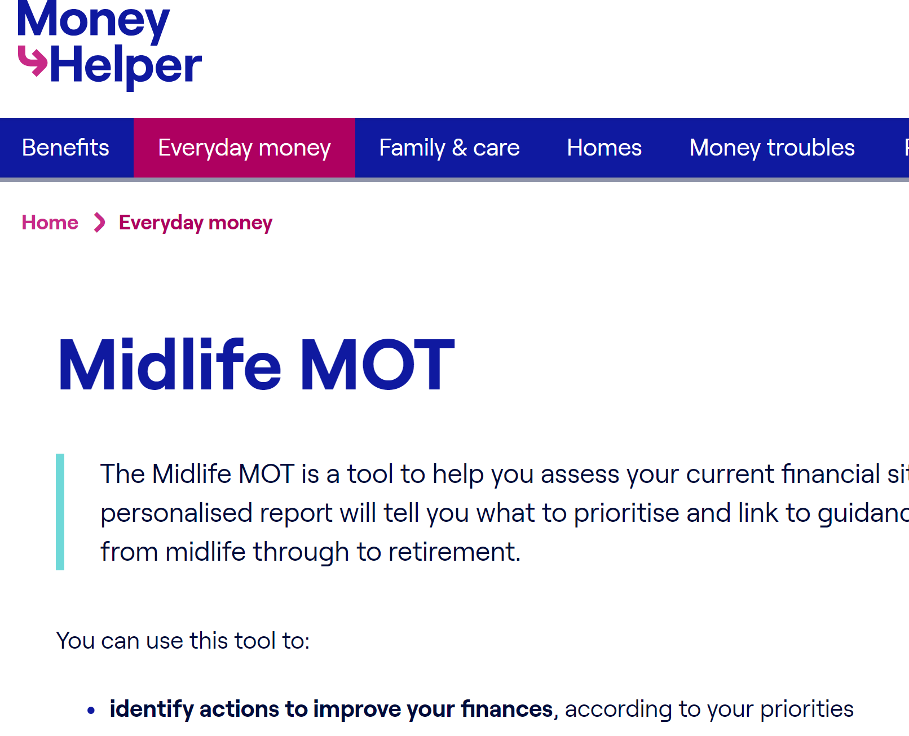
    Mid Life MOT
Pensions Guidance
https://www.moneyhelper.org.uk/en/everyday-money/midlife-mot
Notes:
The Midlife MOT is a tool to help people assess their current financial situation and plan for the future. It asks a series of questions about their finances, covering: debt; budgeting; emergency and non-emergency savings; insurance, and pensions.
It produces a personalised report, which will help them identify what to prioritise and link to guidance on how to improve their financial wellbeing from midlife through to retirement and later life.
This tool can be used to:
identify actions to improve their finances, according to your priorities
help them plan for the future and make sure they stay on track to achieve their goals
This tool works best for people:
between the ages of 45 and 65
living and planning to retire in the UK
They won't need any documents or extra information to use the tool. It will take about 5 minutes to complete.
The information they provide will be kept completely anonymous, but they can download their results.

Slide 21
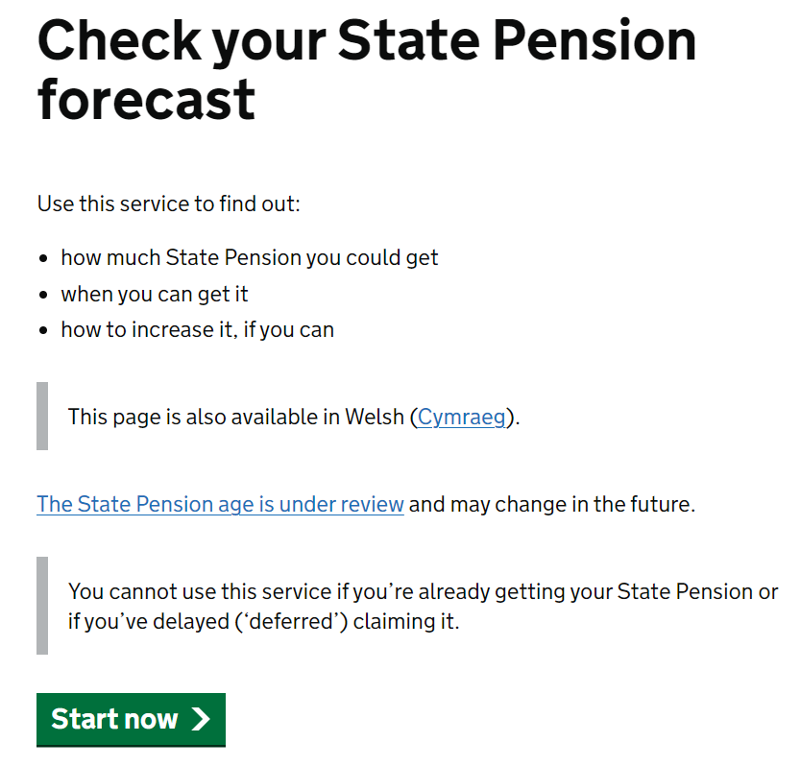
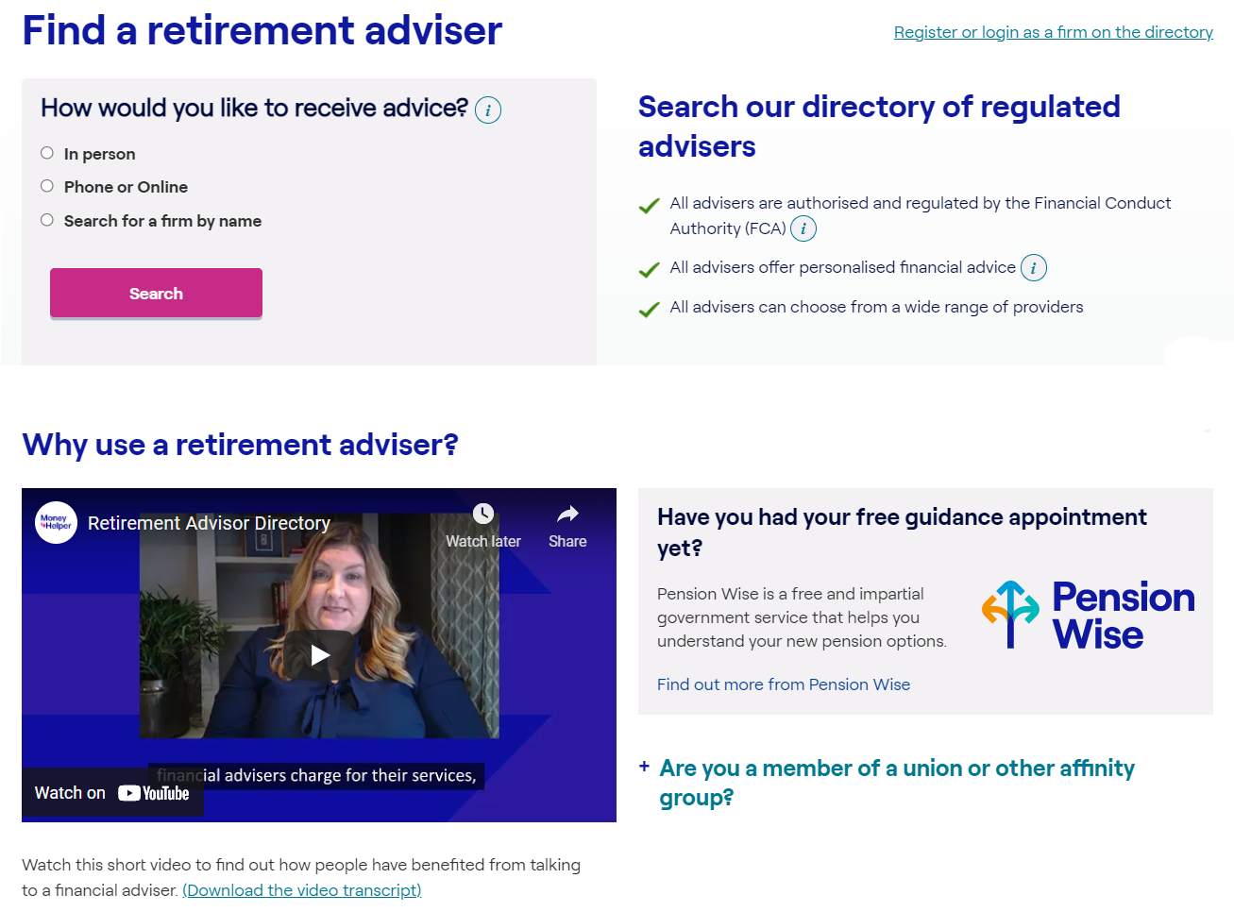
    4. Secure your future – Pensions Guidance and Pension Wise
Find out what your retirement options are, as well as traps to avoid. Book your Pension Wise appointment
  www.moneyhelper.org.uk/pensionwise
Sometimes we all need a professional to help us make the right choices. Find a regulated financial adviser to help with your planning
  https://www.moneyhelper.org.uk/en/pensions-and-retirement/taking-your-pension/find-a-retirement-adviser
Notes:
Retirement savings are important – state pension isn’t enough
You will have an in work pension scheme – you may have had more than one job
You will have different pension pots – helpful link to help you find lost pensions on money helper – just need to know NI and name of employer
Pensionwise – lucky enough to reach age 50 free appt

Slide 22

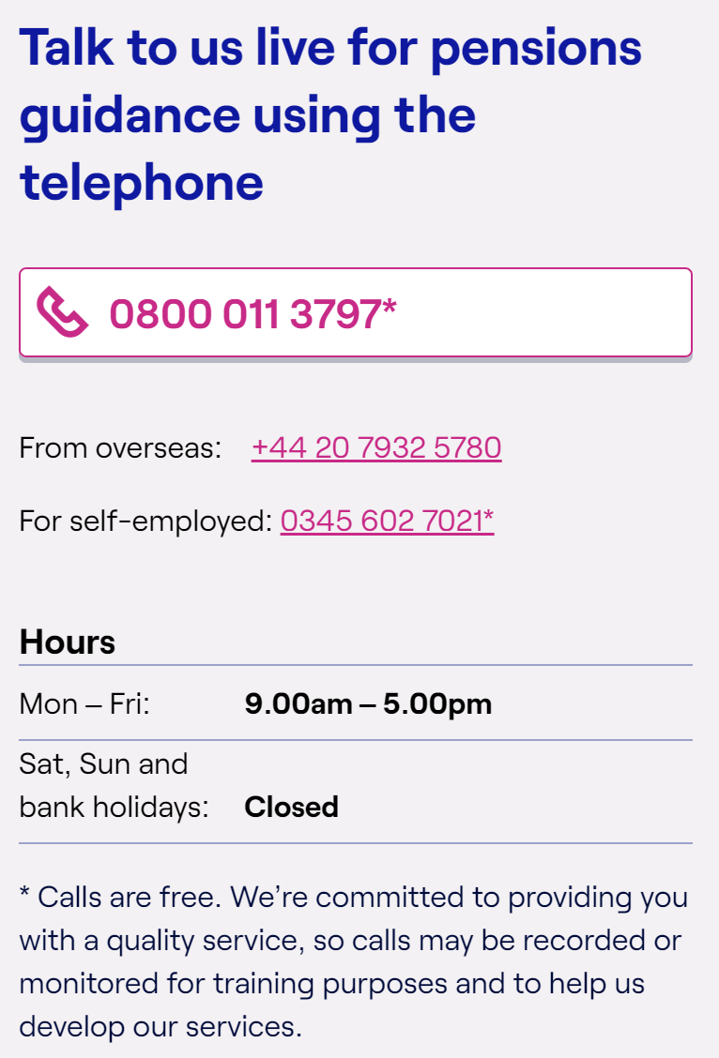
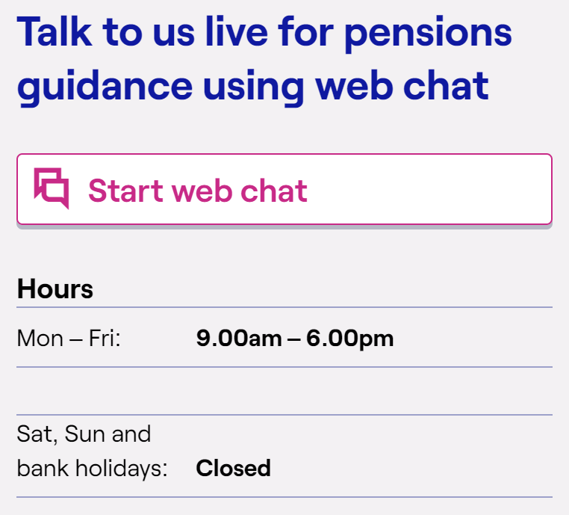
Pensions Guidance
Notes:
These are our numbers for the pension guidance. Our pensions team do understand the NHS pension scheme and will be able to tale you through the features and benefits of the scheme. If it looks as though you would benefit from advice we can we can point you in the right direction of an independent financial adviser

Slide 23
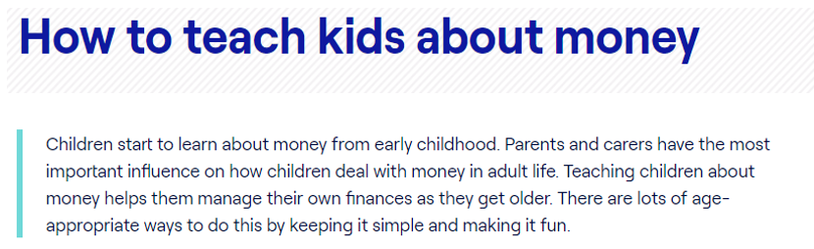


https://www.moneyhelper.org.uk/en/family-and-care/talk-money/talk-learn-do
Notes:
Investments
Pensions
Other savings
State pension £185.15 per week
Medium to longterm savings and investments
Reasons to save medium to longterm – might want to help children with higher education fees

Slide 24



Talk Money Week 2023: #DoOneThing
Our latest research shows that over half of UK adults don’t feel confident in making decisions about financial products and services.
This Talk Money Week, we’re asking people to ‘Do One Thing’:
Ask the people you support to ‘do one thing’ that could help to improve their financial wellbeing, now or in the future
Decide on your ‘one thing’
Tell everyone about it
Ask others to do the same!
Join the conversation at #TalkMoney
Notes:
Brand refresh; theme refresh and why
Explain that we’re asking partners to ask their audiences to ‘do one thing’ that works for them – this could be as simple as checking the address on their pensions
Aiming to launch participation pack and assets next week; TfS to follow by the end of the month

Slide 25

Summary Steps to Financial Wellbeing
    Taking control of your money (Prioritise bills, talk to creditors, do a budget plan)
    Get the money you’re entitled to (Being paid correctly, Benefits calculator)
    Plan for the unexpected (Death, divorce, scams)
    Secure your future (Save for the long term, save for retirement)
Remember to #talkmoney with your family, friends and colleagues
Notes:
We are now going to look at 4 key steps to support financial well-being

Slide 26
Thank you for listening, any questions? www.moneyhelper.org.uk

